Slide 1
Discovery Basics
Bootcamp Module
Instructors: Dr. Manasvita Joshi & Mr. Khajan Joshi

Slide 2
Discovery Overview
Connecting to Discovery
Software on Discovery
GPUs on Discovery
Discovery through OOD
Storage on Discovery
Transferring Data to/from Discovery
Interactive Session Exercises

Slide 3
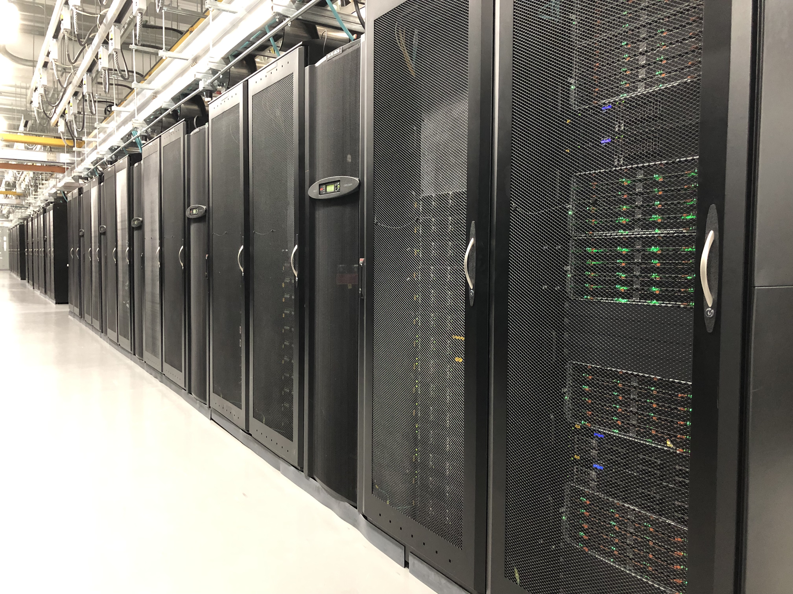
Discovery cluster
Discovery Cluster in MGHPCC (Holyoke, MA). https://www.mghpcc.org/
25k+ public CPU cores, over 200 GPUs, & 1200 nodes.
Connected to Northeastern via 10 Gbps Ethernet (GbE) for high-speed data transfer.
Active, archive, secure, and cloud storage solutions.
https://rc-docs.northeastern.edu/en/latest/hardware/hardware_overview.html

Slide 4
CPU Partitions on Discovery
Partition Name | Requires approval? | Time limit (default/max) | Running jobs | Submitted jobs | Core limit (per user) | RAM limit | Use Case
debug | No | 20 minutes/20 minutes | 10/25 | 5000 | 128 | 256GB | Best for serial and parallel jobs that can run under 20 minutes. Good for testing code.
express | No | 30 minutes/60 minutes | 50/250 | 5000 | 2048 | 25TB | Best for serial and parallel jobs that can run under 60 minutes.
short | No | 4 hours/24 Hours | 50/500 | 5000 | 128 | 25TB | Best for serial or small parallel jobs (--nodes=2 max) that need to run for up to 24 hours.
long | Yes | 1 day/5 Days | 25/250 | 1000 per user/5000 per group | 1024 | 25TB | Primarily for serial or parallel jobs that need to run for more than 24 hours. Need to prove that your code cannot be checkpointed to use this partition.
large | Yes | 6 hours/6 Hours | 100/100 | 1000 per user/5000 per group | N/A | N/A | Primarily for running parallel jobs that can efficiently use more than 2 nodes. Need to demonstrate that your code is optimized for running on more than 2 nodes.
https://rc-docs.northeastern.edu/en/latest/hardware/partitions.html

Slide 5
GPU Partitions on Discovery
Partition Name | Requires approval? | Time limit (default/max) | Running jobs | Submitted jobs | GPU per job limit | GPU per user limit | Use Case
gpu | No | 4 hours/8 Hours | 25/250 | 50/100 | 1 | 8 | For jobs that can run on a single GPU processor.
multigpu | Yes | 4 hours/24 Hours | 25/100 | 50/100 | 12 | 12 | For jobs that require more than one GPU and take up to 24 hours to run.
If you need access to large, long, or multigpu partitions, you need to submit a ServiceNow ticket.

Slide 6
Request A Discovery Account
Need to have an NU account & a sponsor before requesting a Discovery account.
Sponsor approves your access request form.
All student club members must indicate Slurm account they would like to be associated with & communicate to RC.
Access request form and more information available on https://rc-docs.northeastern.edu/en/latest/get_started/get_access.html

Slide 7
Connecting - Demo
Mac: Use Terminal
Windows: Use MobaXterm
ssh -Y <username>@login.discovery.neu.edu – With X11 Forwarding
ssh <username>@login.discovery.neu.edu – Without X11 Forwarding
https://rc-docs.northeastern.edu/en/latest/get_started/connect.html

Slide 8
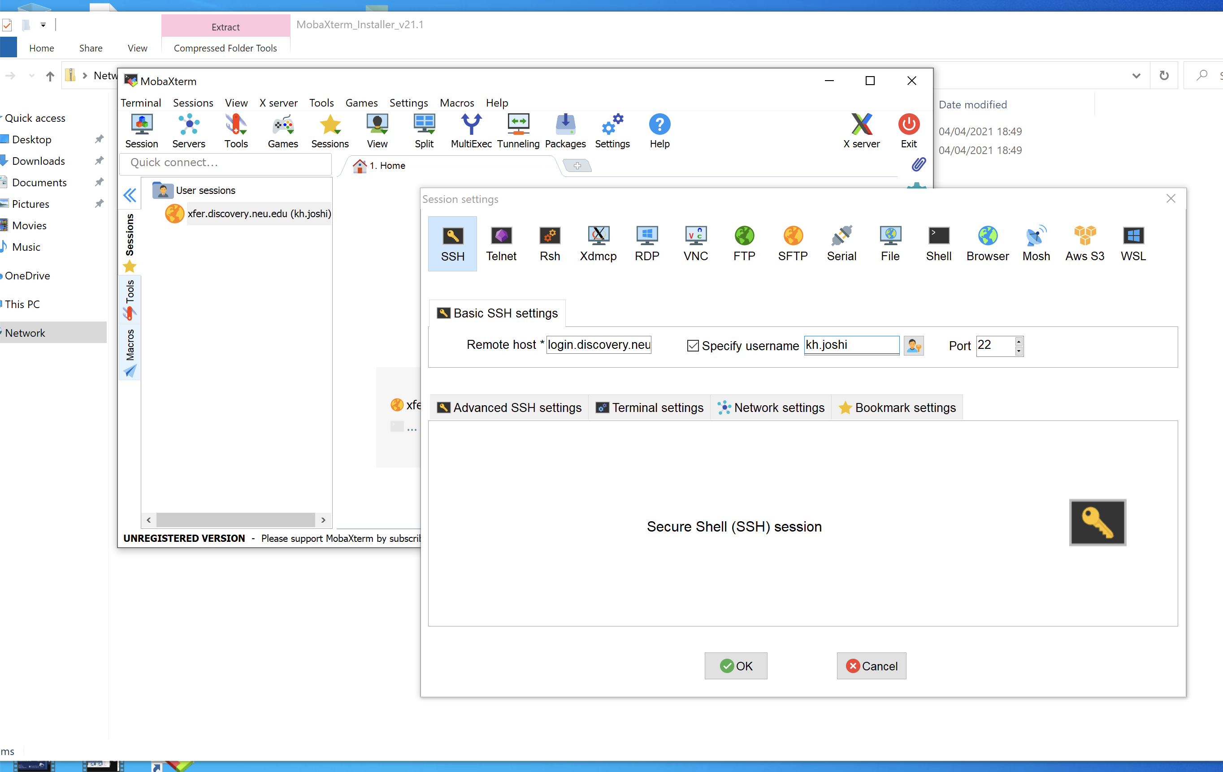
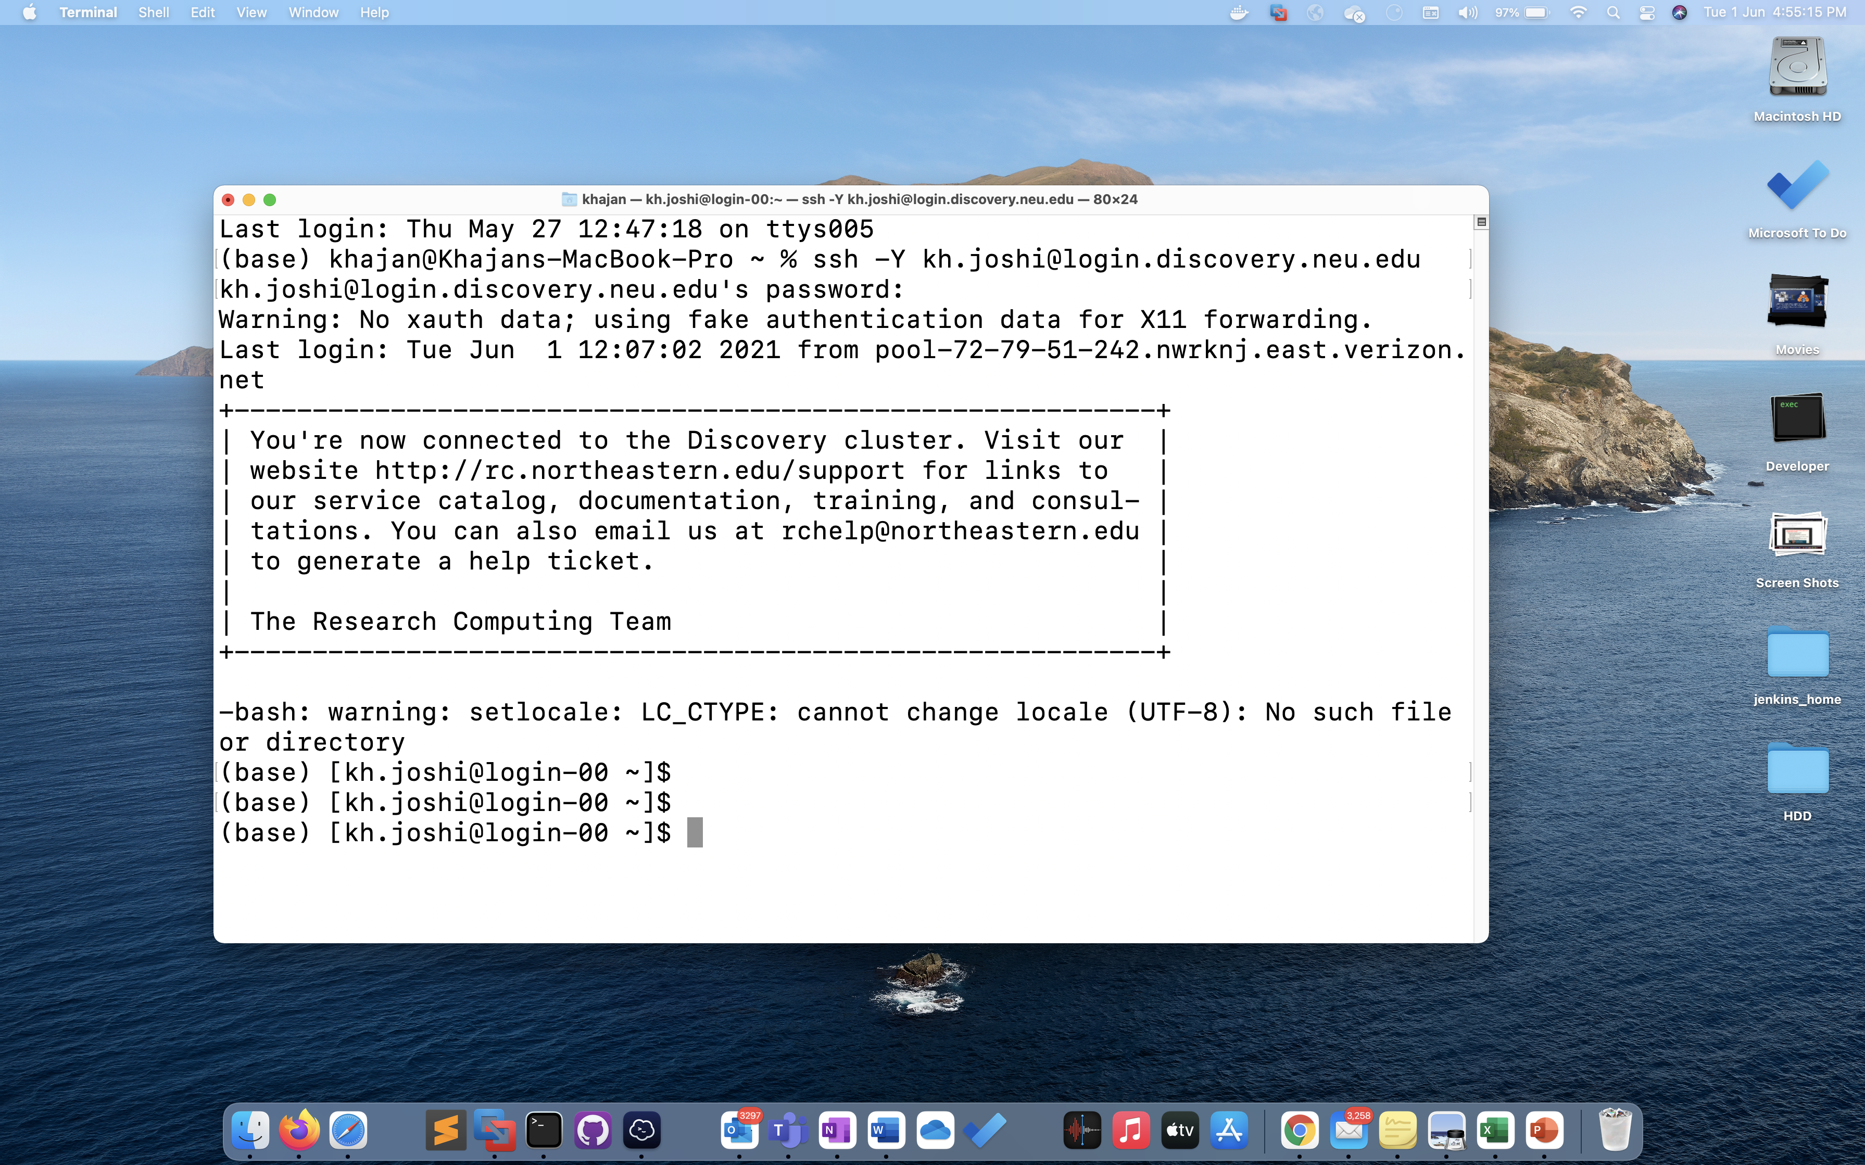
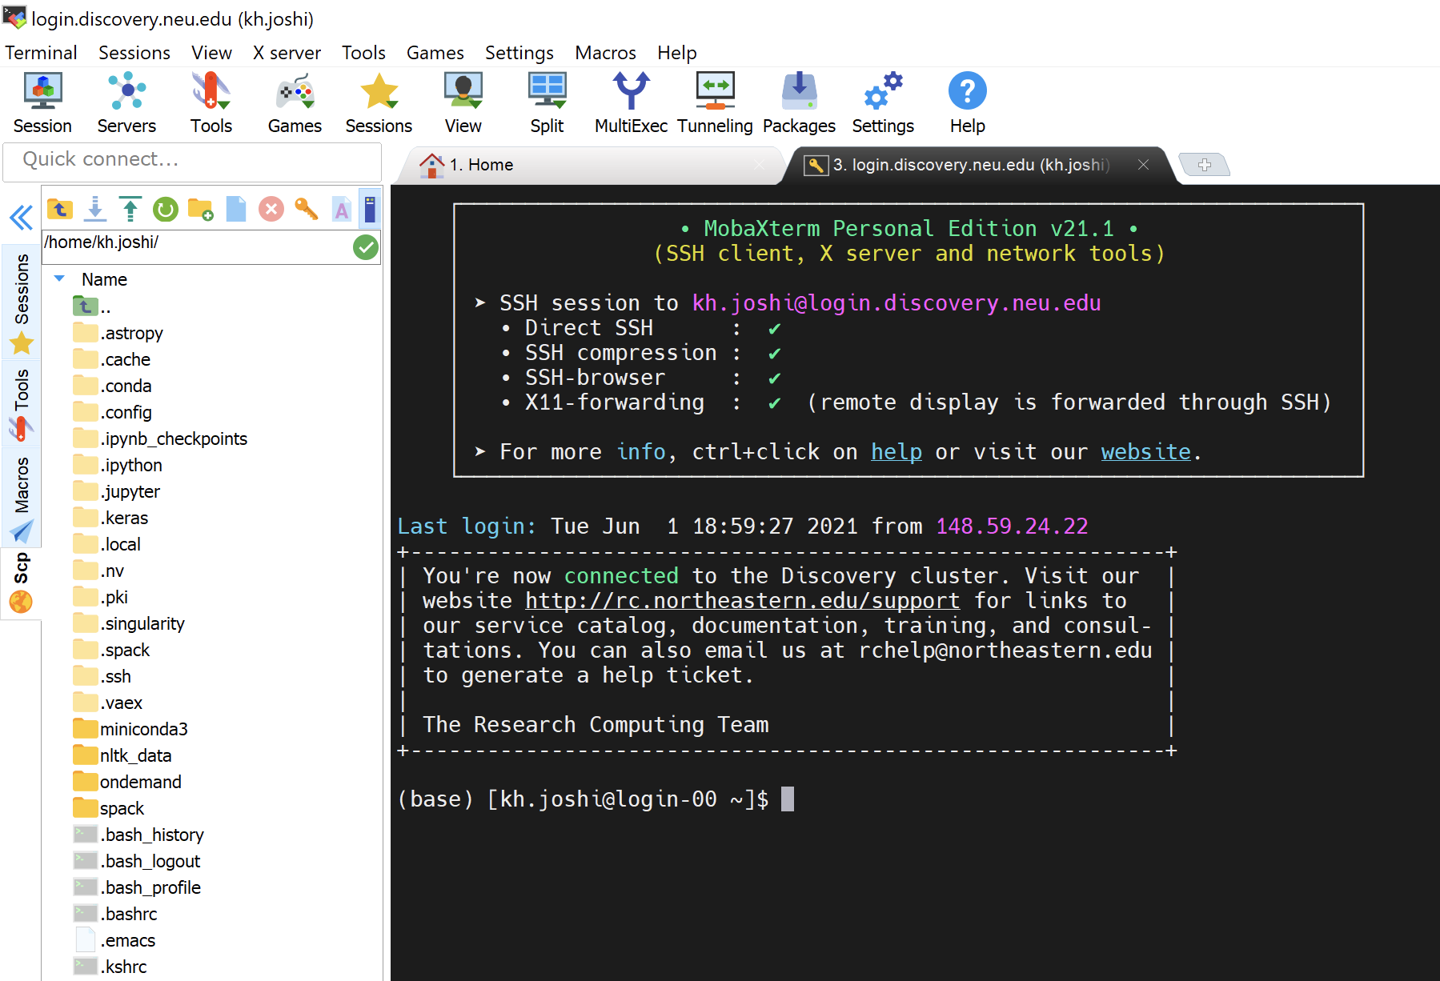
LOGIN TO DISCOVERY
$ ssh –Y username@login.discovery.neu.edu
MAC (Terminal)
Windows (MobaXterm)

Slide 9
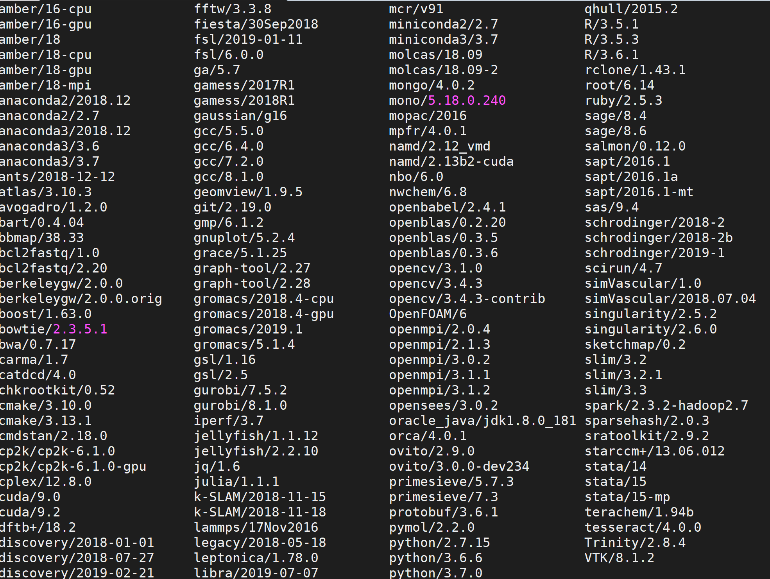
Software on Discovery
Popular software packages available as modules.
module avail - Demo
Install software to your local directory.
We ask users to always have clean .bashrc file.
Request software installation through ServiceNow. https://service.northeastern.edu/tech?id=sc_cat_item&sys_id=777c510bdbebd340a37cd206ca9619b0
Details in June 9 session at 9 AM.

Slide 10
GPUs on Discovery
All NVIDIA GPUs on Discovery.
Range from K40 to T4.
https://rc-docs.northeastern.edu/en/latest/using-discovery/workingwithgpu.html
Access gpu partition using --gres= flag while running srun or sbatch.
More details in June 9 session at 10:30 AM.
Notes:
The Discovery cluster supports a variety of GPUs that offer a wide range of functionalities and capabilities.
k20m - The Tesla K20m is an enthusiast-class professional graphics card developed by NVIDIA, which was launched in January 2013. It is built on 28 nm process, is based on the GK110 graphics processor, and supports DirectX 12. For full specifications, see [7].
k40m - The Tesla K40m is an enthusiast-class professional graphics card developed by NVIDIA, which was launched in November 2013. It is built on 28 nm process, based on the GK110B graphics processor, and supports DirectX 12. For full specifications, see [8].
k80 - The Tesla K80 is a professional graphics card developed by NVIDIA, which was launched in November 2014. It is built on 28 nm process, is based on the GK210 graphics processor, and supports DirectX 12. Advertized as the world's most popular GPU on NVIDIA website, it delivers exceptional performance with fewer, more powerful servers that tremendously reduces data center costs and boosts throughput 5-10 times more in real-world applications. For full specifications and details, see [9, 10].
p100 - The Tesla P100 is an enthusiast-class professional graphics card developed by NVIDIA, which was launched in June 2016. It is Built on 16 nm process, is based on the GP100 graphics processor, and supports DirectX 12. Advertised as the world's first AI supercomputing data center GPU on NVIDIA website, it offers a unified platform for accelerating both HPC and AI, and dramatically increases throughput. For full specifications and details, see [11, 12].
v100-pcie & v100-sxm2 - The Tesla V100 series is a professional graphics card developed by NVIDIA, which was launched in March 2018. It is built on 12 nm process, is based on the GV100 graphics processor, and supports DirectX 12. Advertised as the first tensor core GPU on NVIDIA website, it is the most advanced data center GPU for AI. It comes in 16 and 32GB configurations. It offers performance of up to 32 CPUs wrapped up in a single GPU. For full specifications and details, see [13, 14, 15].
T4 - The Tesla T4 is a professional graphics card developed by NVIDIA, which was launched in September 2018. It is built on 12 nm process, is based on the TU104 graphics processor, and supports DirectX 12 Ultimate. This GPU offers breakthrough performance by accelerating various computing environments ranging from cloud to AI & graphics. It is energy-efficient and features multi-precision Turing Tensor Cores, providing up to 500 trillion tensor operations per second, and new RT Cores, for performing ray tracing operations with extraordinary efficiency. For full specifications and details, see [16, 17].
The latest Tesla 20-series GPUs are based on the latest implementation of the CUDA platform called the "Fermi architecture". Fermi has key computing features such as 500+ gigaflops of IEEE standard double-precision floating-point hardware support, L1 and L2 caches, ECC memory error protection, local user-managed data caches in the form of shared memory dispersed throughout the GPU, coalesced memory accesses, and more.

Slide 11
Accessing Discovery Through OOD
Open OnDemand (OOD) – web portal to Discovery cluster.
Various Interactive Apps available on OOD, including Jupyter notebook, JupyterLab, Knime, & WEKA ML platforms.
Any OS: Use a web browser and go to https://rc-docs.northeastern.edu/en/latest/using-ood/introduction.html
Manage files on Discovery using OOD
https://rc-docs.northeastern.edu/en/latest/using-ood/fileexplore.html
More details in June 8 session at 9 AM.

Slide 12
Storage On Discovery
Home
Permanent & Backed up
Limited size (100GB)
Not performant
https://rc-docs.northeastern.edu/en/latest/storage/discovery_storage.html
More details in June 9 session at 2:45 PM.
Scratch
Performant
Total capacity: 1.8 PB
Temporary storage
Not backed up
28 day purge policy
rc.northeastern.edu/policy

Slide 13
Transferring Data To/From Discovery
Using compute node via scp
Using xfer via sshfs
https://rc-docs.northeastern.edu/en/latest/using-discovery/transferringdata.html
Using Globus
https://rc-docs.northeastern.edu/en/latest/using-discovery/globus.html
More details in June 9 session at 2:45 PM.

Slide 14
Interactive Session Exercises

Slide 15
BASIC UNIX COMMANDS

Slide 16
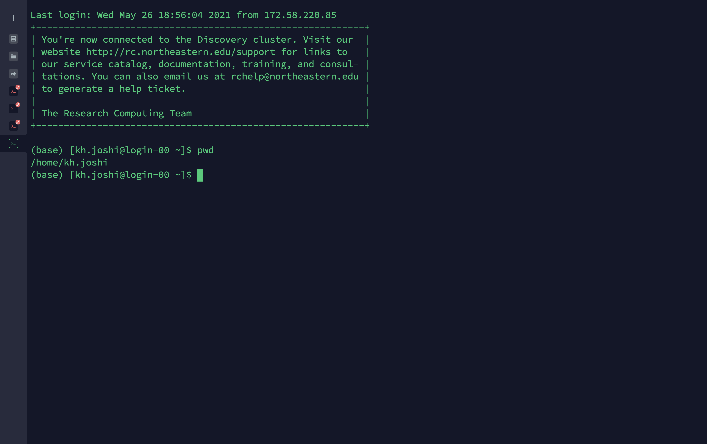
BASIC UNIX COMMANDS
pwd (to print the current working directory)

Slide 17
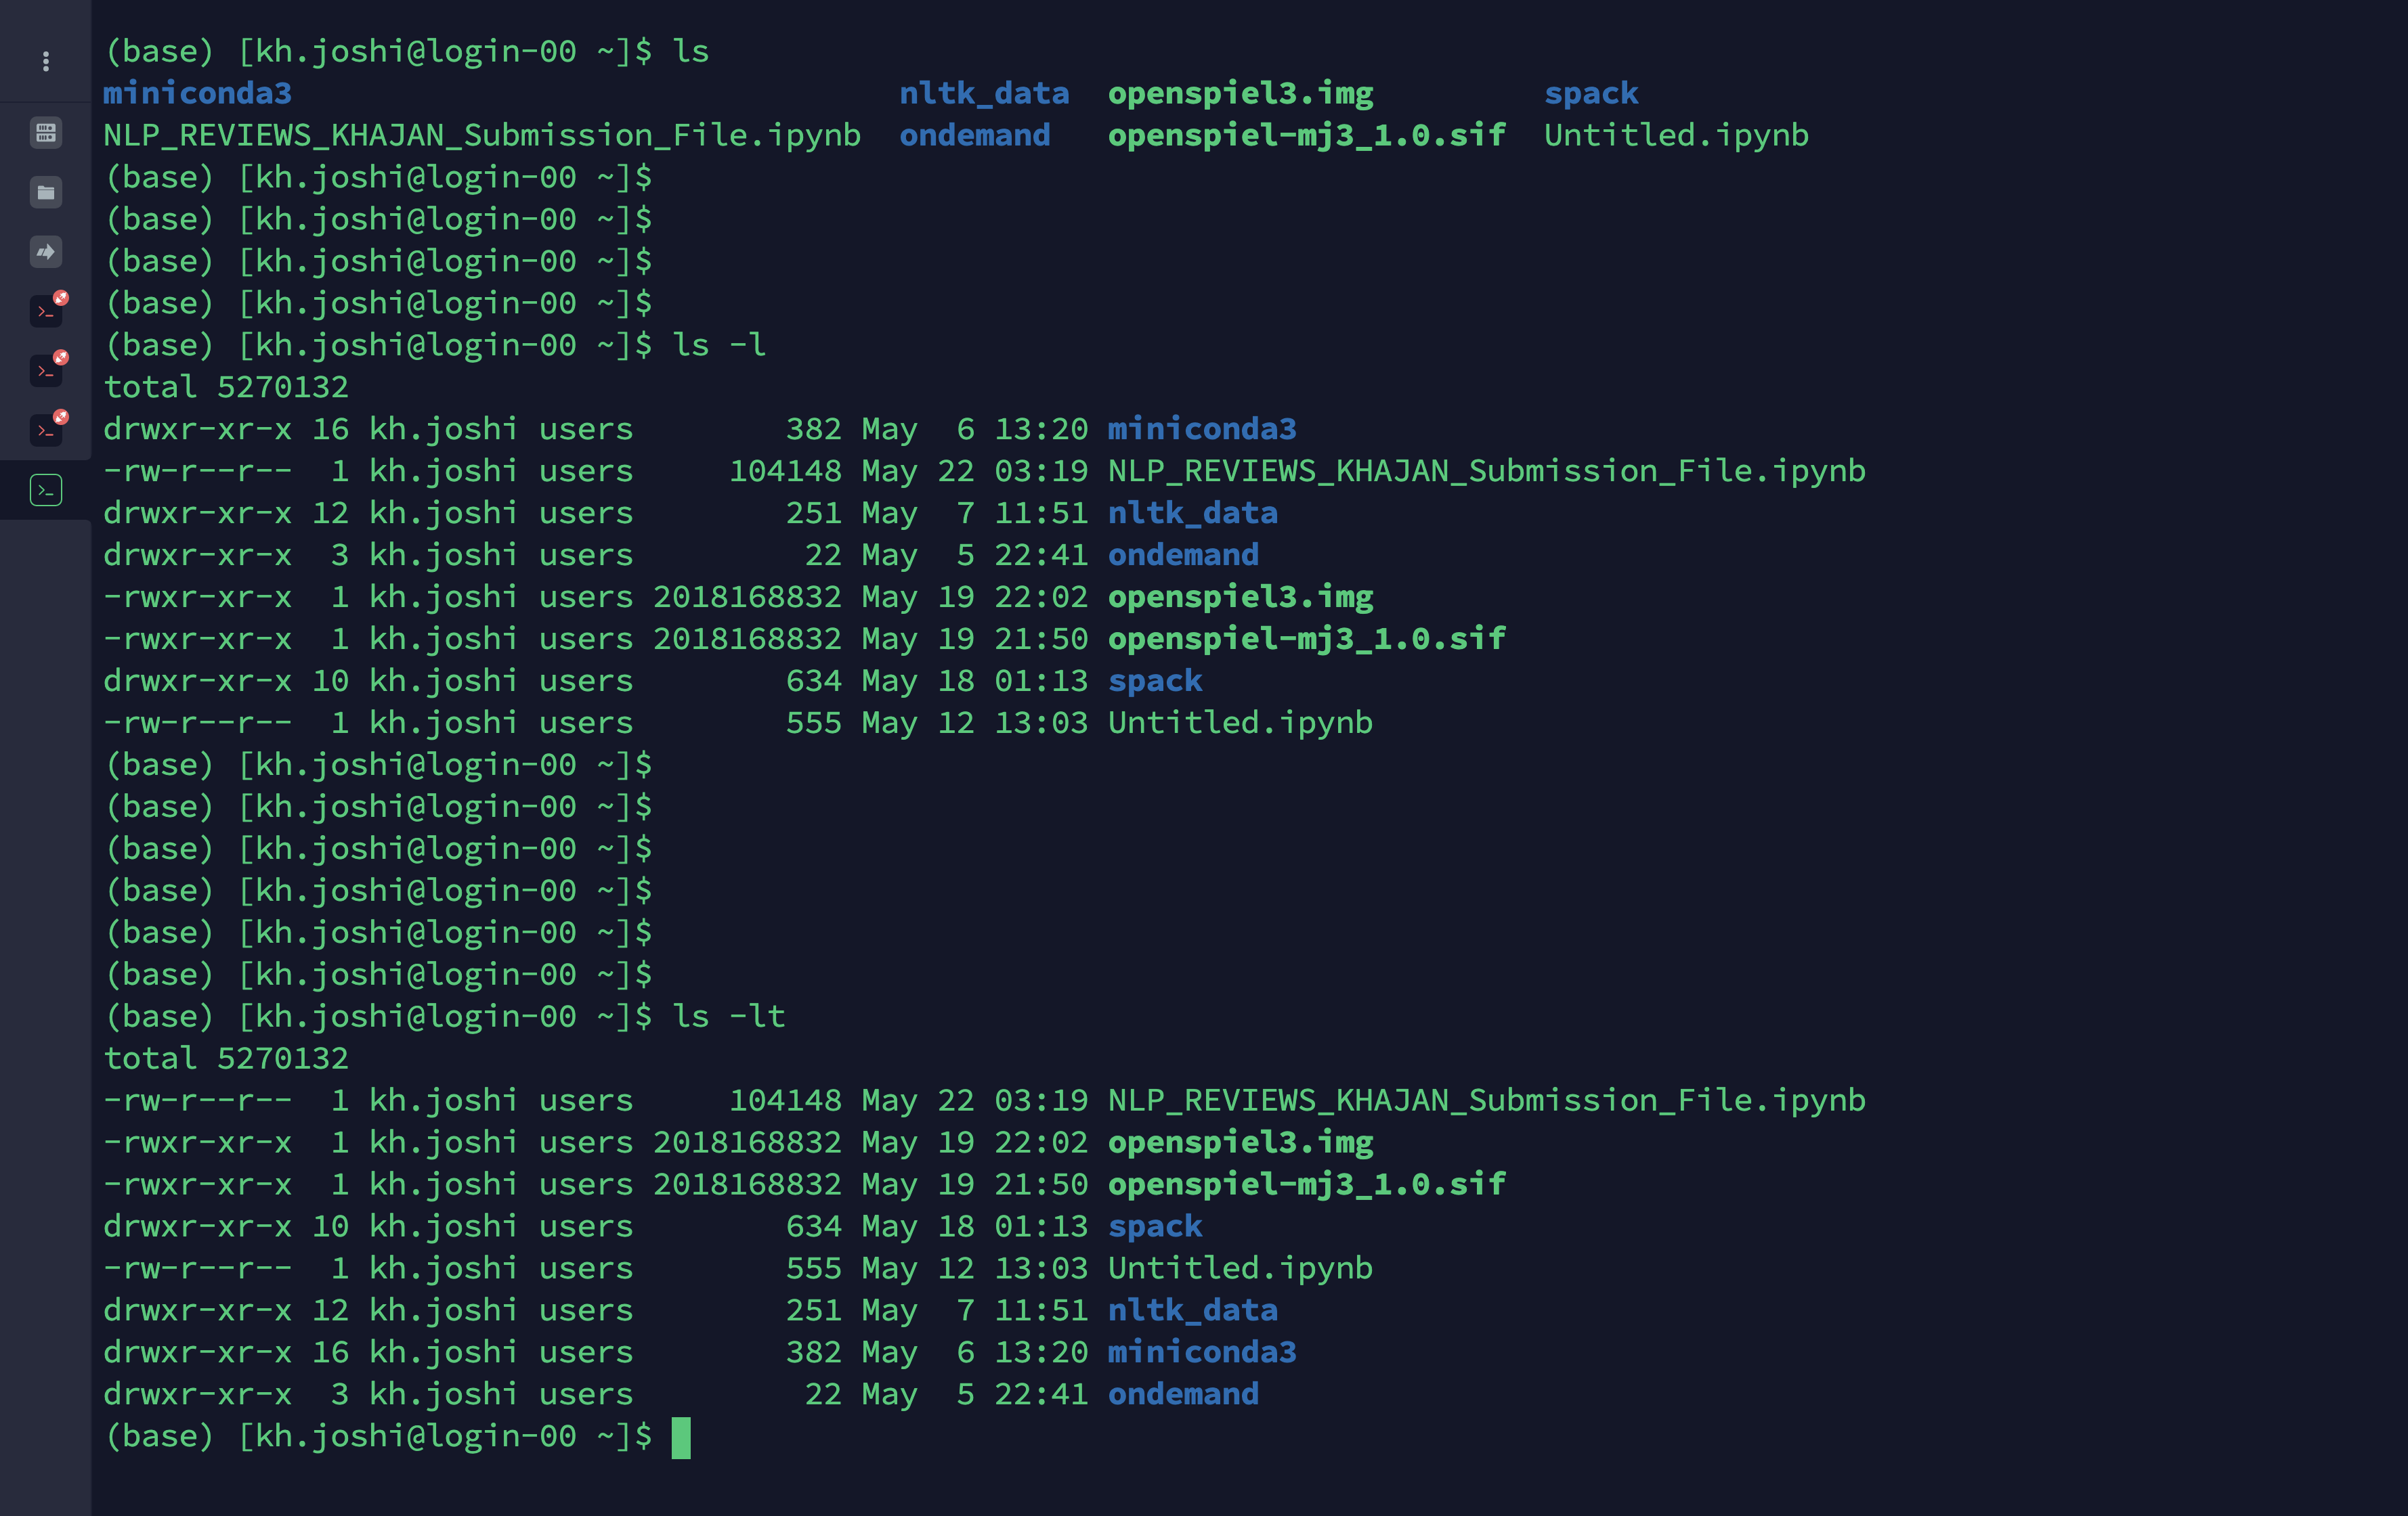
BASIC UNIX COMMANDS
ls (to list files or directories)
Note: ls -ltr (l - as a list, t - ordered by time, r - to reverse the order)

Slide 18
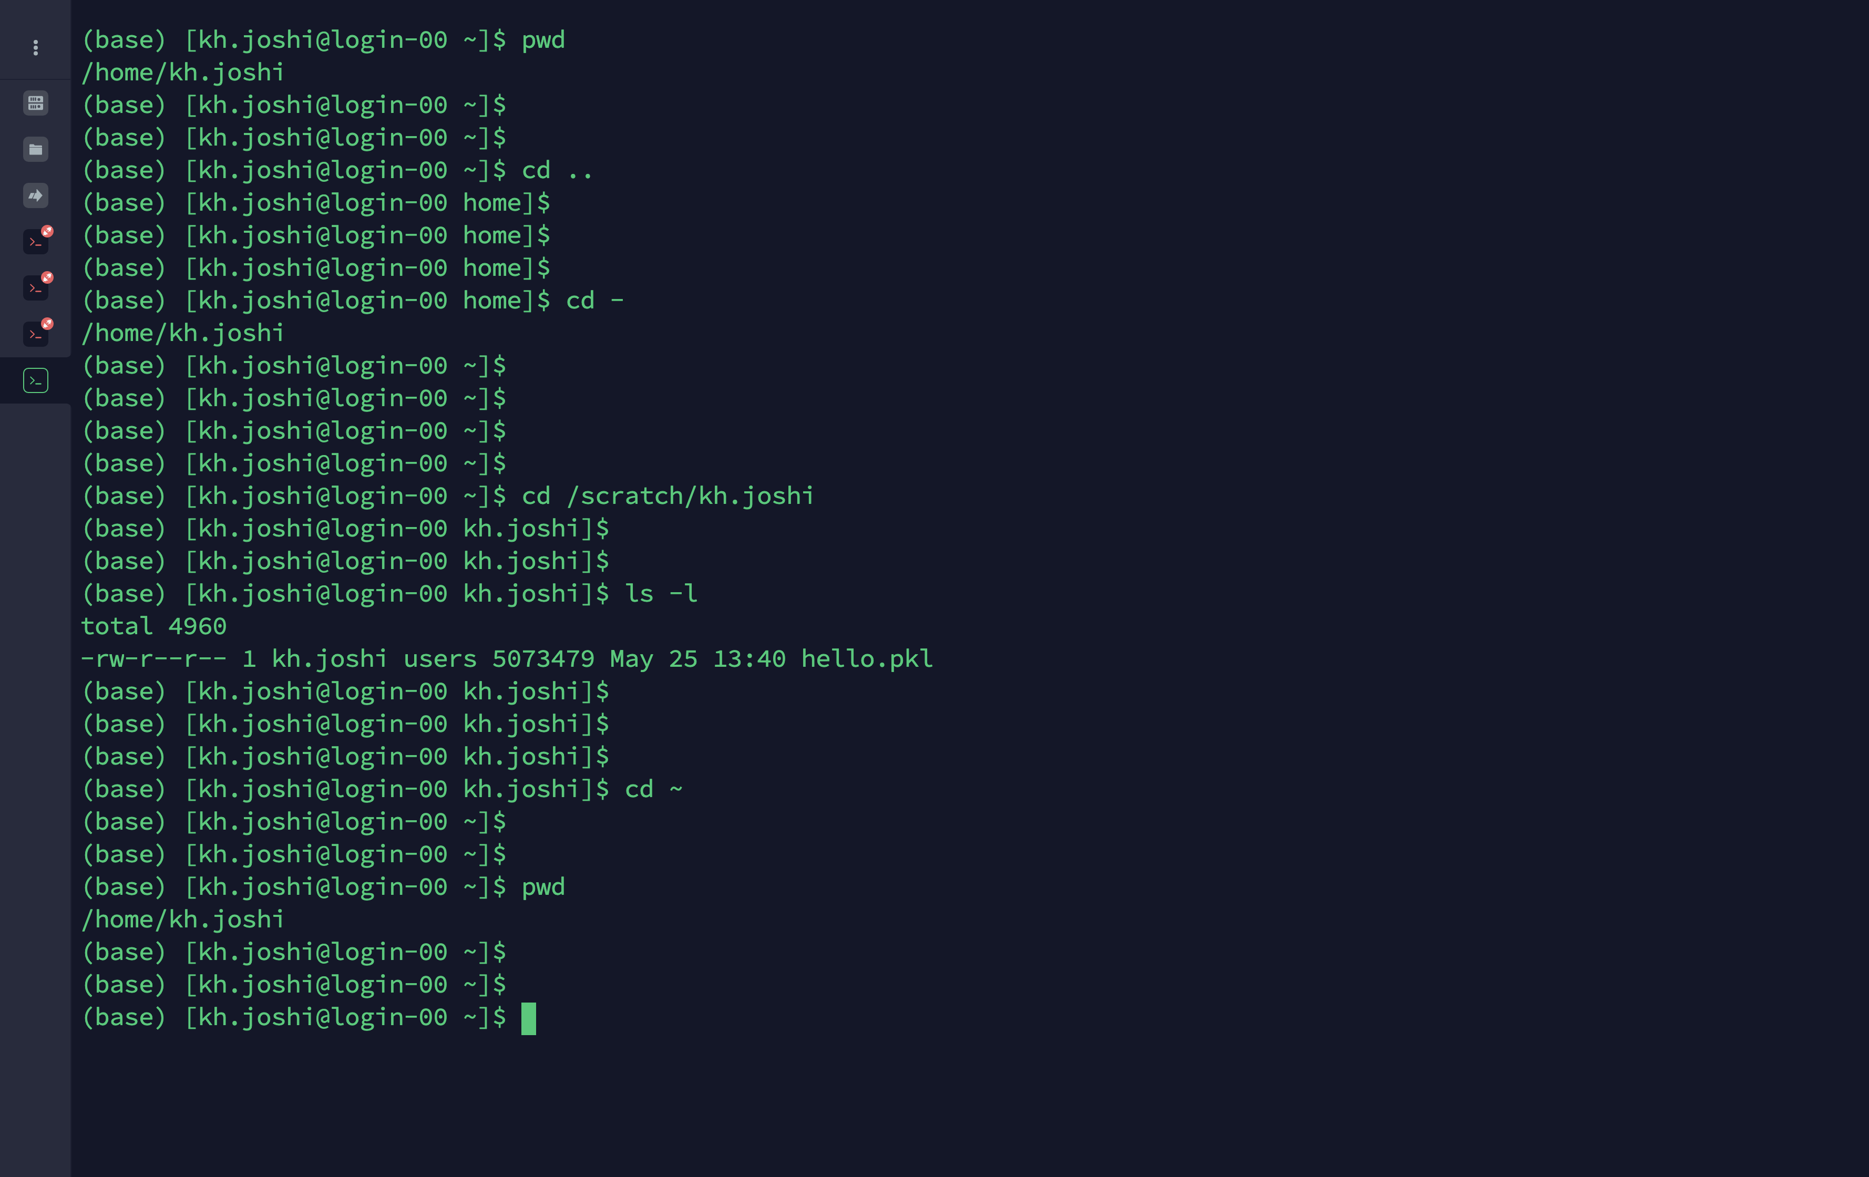
BASIC UNIX COMMANDS
cd (to change directory)
cd .. (cd to one directory up)
cd – (cd back to previous directory)
cd ~ (cd to home directory)

Slide 19
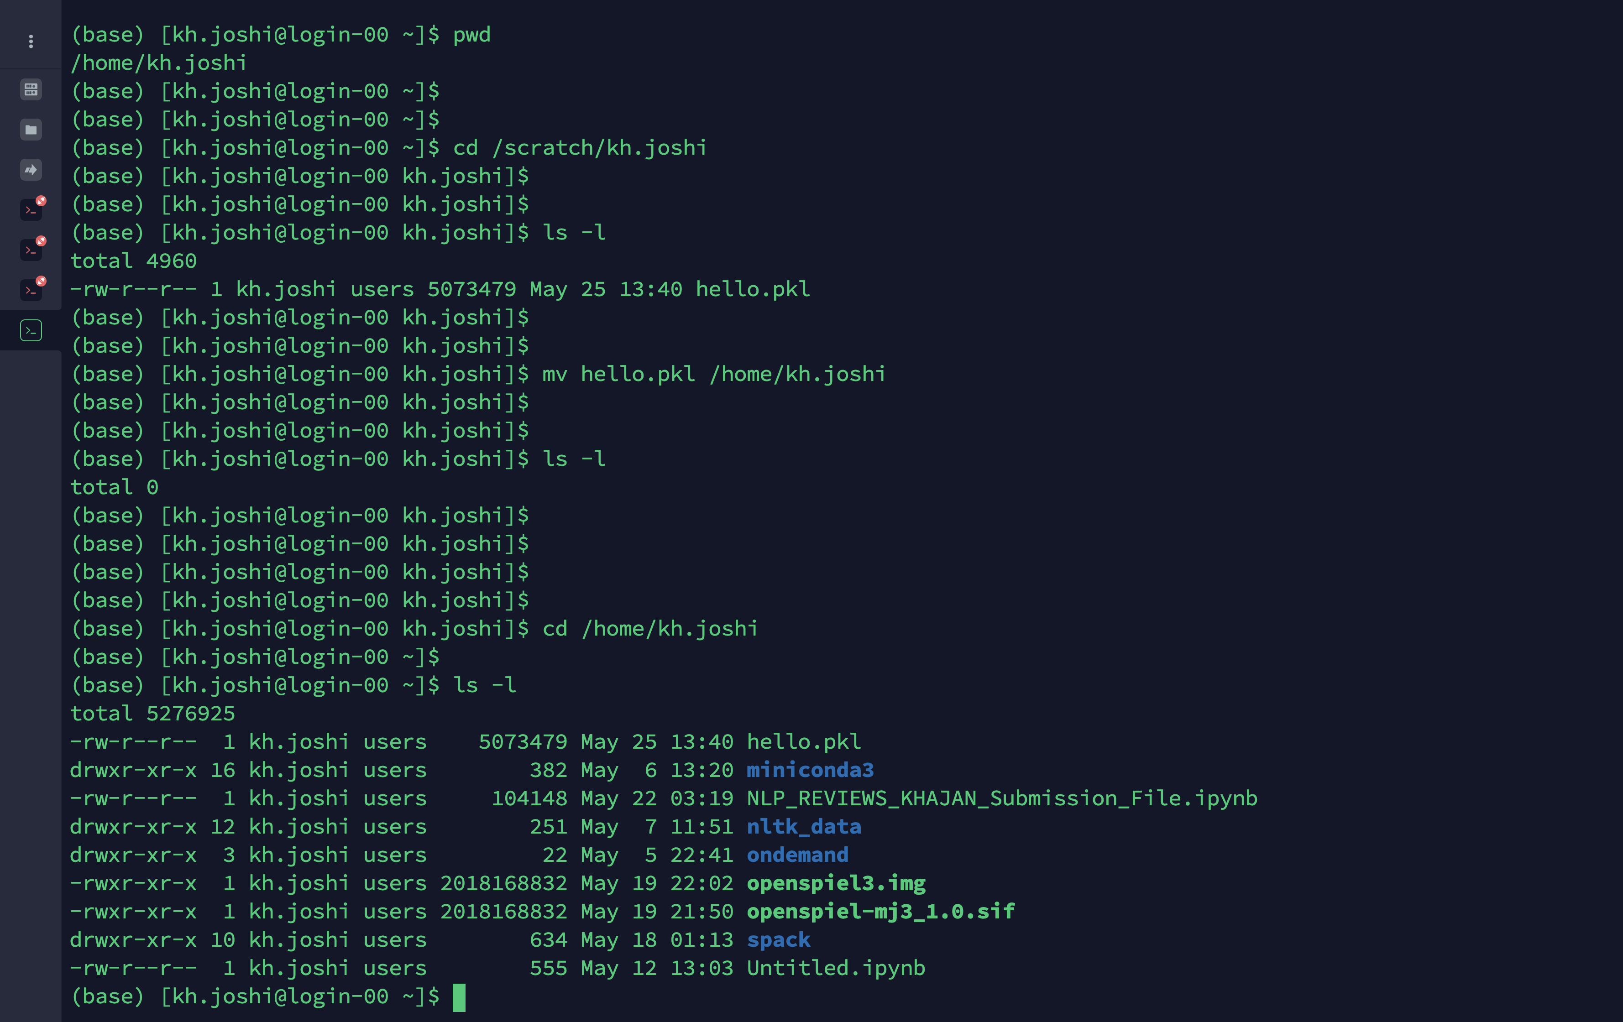
BASIC UNIX COMMANDS
mv (to move a file)

Slide 20
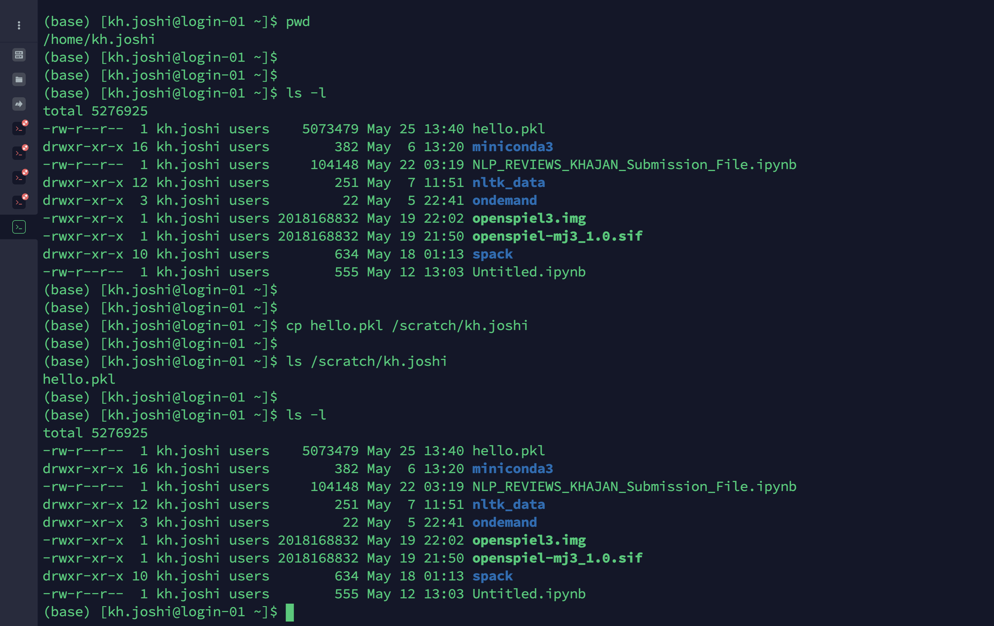
BASIC UNIX COMMANDS
cp (to copy a file)

Slide 21
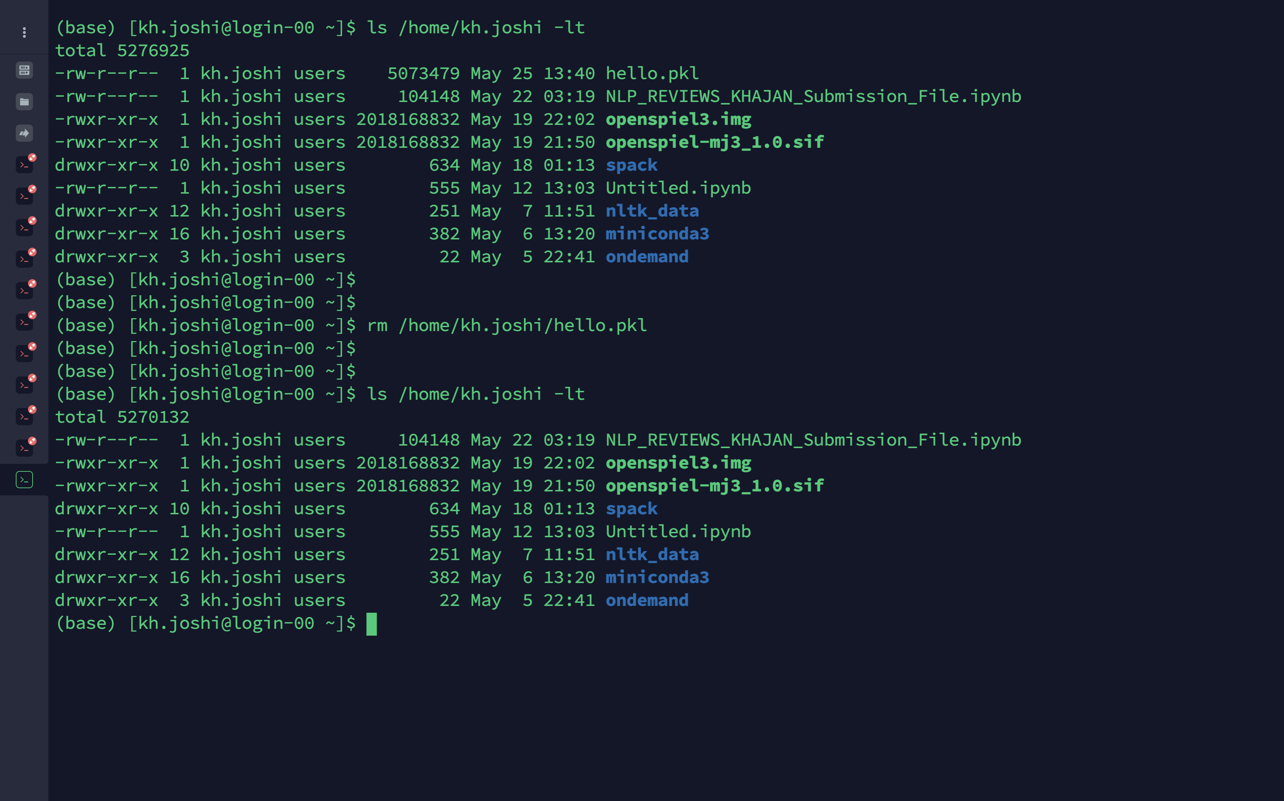
BASIC UNIX COMMANDS
rm (to remove a file)

Slide 22
Submitting a job on Discovery
Using srun –
Interactive way of submitting jobs
Eg: srun --pty /bin/bash
To request resources (partition, time, memory, cpu) using SRUN command, provide these options while executing it.
See https://rc-docs.northeastern.edu/en/latest/hardware/partitions.html for information on various partitions & their time limits, etc.
Using SBATCH –
Submitting jobs non-interactively
Eg: sbatch example.script
To request resources using SBATCH, the example.script file must contain resource details, such as partition, time, memory, cpu.

Slide 23
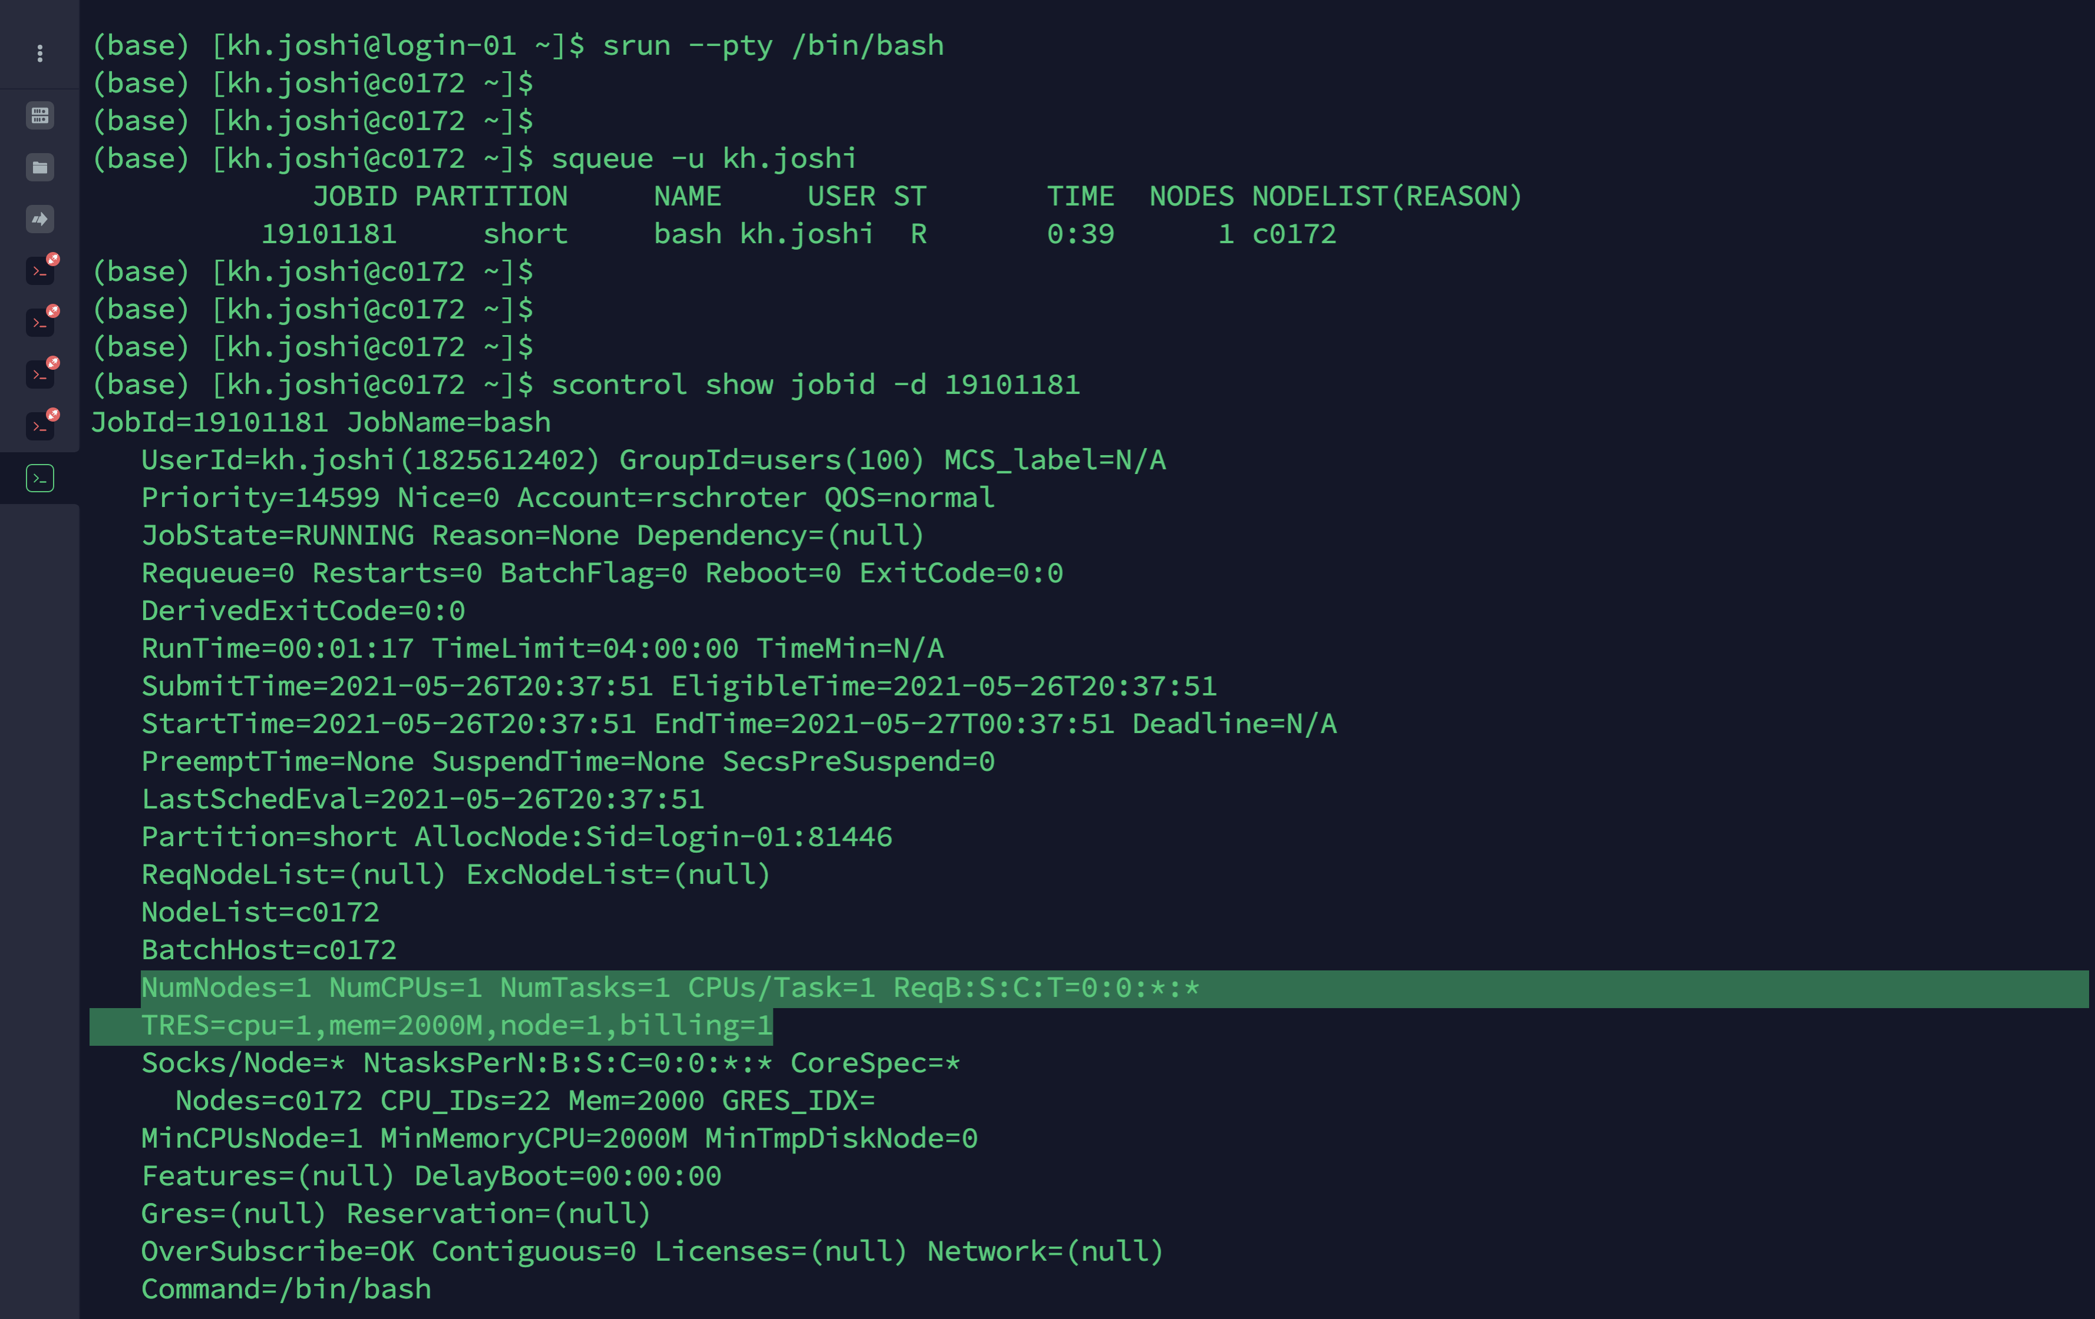
Submitting a job on Discovery
Using SRUN

Slide 24
Exercise 1
Submitting an interactive job using SRUN

Slide 25
Exercise 1 SRUN (Run and monitor jobs on a compute node)
In this example, we’ll run an interactive job on the cluster, using SRUN.
SRUN (request one node, with 10 tasks and 2 CPUs per task (a total of 20 CPUs), 1GB of memory, for one hour on the express partition):
To see JOB ID:
To see details of jobs:
To see more details of your job:
To see the computational efficiency of your calculations:
Example: to start a python interactive session
To cancel a job:
$ srun --nodes=1 --ntasks=10 --cpus-per-task=2 --mem=1G --time=01:00:00 --partition=express --pty --export=ALL /bin/bash
$ srun --nodes=1 --ntasks=10 --cpus-per-task=2 --mem=1G --time=01:00:00 --partition=reservation –-reservation=bootcamp2021cpu --pty --export=ALL /bin/bash (For this session)
$ squeue –u <username>
$ scontrol show jobid -d <job_id>
$ seff <job_id>
$ python sample_script.py
$ scancel <job_id>

Slide 26
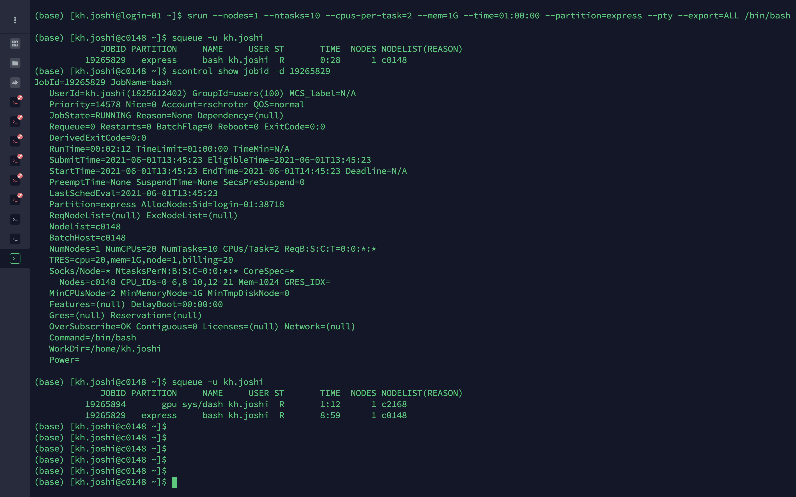
Exercise 1 Submit your job (using slurm commands)
1. SRUN
$ srun --nodes=1 --ntasks=10 --cpus-per-task=2 --mem=1G --time=01:00:00 --partition=express --pty --export=ALL /bin/bash

Slide 27
Exercise 1 Monitor your job
2. See your jobs with squeue
$ squeue –u <username>

Slide 28
Exercise 1 See job details
3.1. Monitoring your job with scontrol
$ scontrol show jobid -d <job_id>

Slide 29
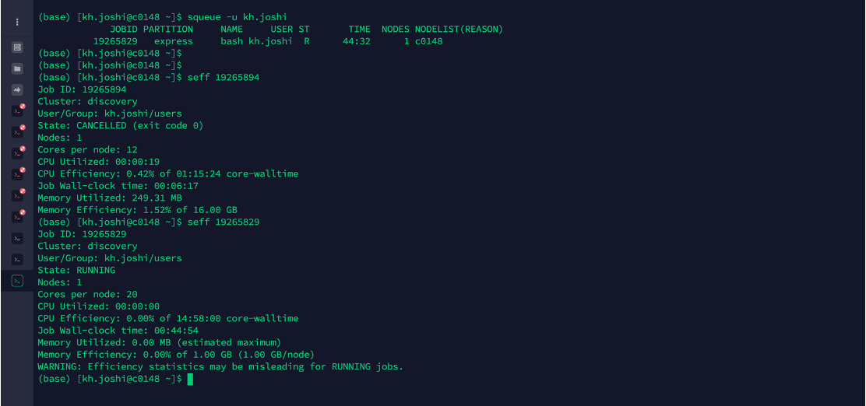
Exercise 1 See job efficiency
3.2. seff (to see the computational efficiency of your calculations)
$ seff <job_id>

Slide 30
Exercise 1 See account details
See if you are associated with multiple slurm accounts sacctmgr show associations where user=username
Choose the correct Slurm account to submit your job srun --account=accountname --partition=short --nodes=1 --ntasks=28 --pty --mem=16 GB /bin/bash
https://rc-docs.northeastern.edu/en/latest/using-discovery/usingslurm.html

Slide 31
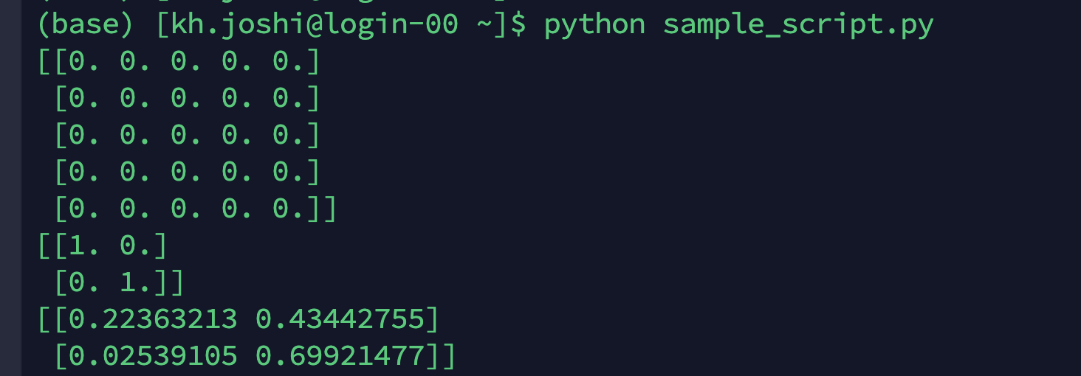
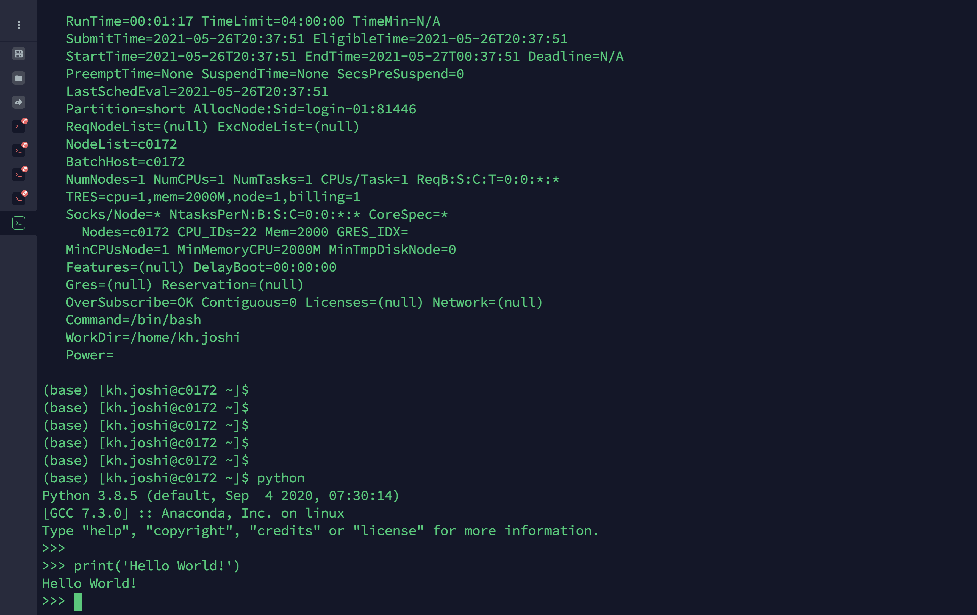
Exercise 1 Do computations on the compute node
4. Example: To start a python interactive session
$ python sample_script.py
5. Cancel a pending or running job on the cluster
$ scancel <job_id>
or
$ exit

Slide 32
Exercise 2
Submitting a non-interactive job using SBATCH

Slide 33
Exercise 2 SBATCH (Run jobs in the background)
Batch script has 3 main sections – Shebang, SBATCH directives & Instructions. Create an sbatch file using a text editor.
#!/bin/bash
#SBATCH --partition=reservation
#SBATCH –-reservation=bootcamp2021cpu
#SBATCH --job-name=test
#SBATCH --time=00:05:00
#SBATCH –-nodes=1
#SBATCH –-cpus-per-task=1
#SBATCH --output=%j.output
#SBATCH --error=%j.error
echo "HELLO WORLD!”
Shebang – path to Bash interpreter that runs lines in file.
SBATCH directives –
Tell Slurm to allocate resources to run a job successfully.
Partition name where job needs to run.
Duration for which job is expected to run.
Number of nodes & CPUs requested.
Job name and output & error files.
%j – job ID number
Instruction – Bash command to execute when job runs

Slide 34
Exercise 2 Submit job using SBATCH
See sample.bash in Exercise2 folder.
Jobs should be submitted from login terminal using:
You should see the following output:
When the job finishes, you should have: JOBID.output & JOBID.error
If the job completed successfully,
<jobid>.error should be empty, &
<jobid>.output should contain the output "Hello World".
$ sbatch sample.bash
$ Submitted batch job <jobid>

Slide 35
Exercise 3
Submitting a simple array job

Slide 36
Exercise 3 Array Jobs (Run multiple jobs in the background)
Multiple jobs (sub jobs) can be submitted at once and run in parallel using slurm’s --array directive.
Number of jobs that can run in parallel depends on the limit of simultaneous processes allowed on a cluster.
Even if within the limit, it’s not guaranteed that all sub jobs will get executed simultaneously. Depends on the amount of resources available at the time.
Regardless, all sub jobs will get executed in some order and will still be more efficient compared to submitting and running 1000s of similar jobs on the cluster manually.
https://docs.csc.fi/computing/running/array-jobs/
https://scicomp.aalto.fi/triton/tut/array/
https://slurm.schedmd.com/job_array.html

Slide 37
Exercise 3 Array Jobs (Run multiple jobs in the background)
#!/bin/bash
#SBATCH --partition=reservation
#SBATCH –-reservation=bootcamp2021cpu
#SBATCH --job-name=test
#SBATCH --time=00:05:00
#SBATCH –-nodes=1
#SBATCH –-cpus-per-task=1
#SBATCH --output=%A_%a.output
#SBATCH --error=%A_%a.error
#SBATCH --array=1-4%4
echo "Job array ID: $SLURM_ARRAY_JOB_ID , sub-job $SLURM_ARRAY_TASK_ID is running!"
cd d$SLURM_ARRAY_TASK_ID
cat a.txt
$SLURM_ARRAY_JOB_ID – Job array ID
$SLURM_ARRAY_TASK_ID – Sub-job ID
#SBATCH --array=1-4%4” – Submits the job 4 times with sub-job ID ranging from 1 to 4. Run a 4-job array.
% => how many to run at once
%A – $SLURM_ARRAY_JOB_ID
%a – $SLURM_ARRAY_TASK_ID
Each sub-job enters the directory matching its ID & executes cat command.

Slide 38
Exercise 3 Submit array job using SBATCH
See sample_array_job.bash in Exercise3 folder.
Jobs should be submitted from login terminal using:
You should see the following output:
When the job finishes, you should have 4 JOBID_SUBJOBID.output & JOBID_SUBJOBID.error files.
If the job completed successfully,
jobid_subjobid.error should be empty, &
jobid_subjobid.output should have the contents of a.txt as output.
$ sbatch sample_array_job.bash
$ Submitted batch job <jobid>

Slide 39
Thank you

Slide 40
Supplemental Material

Slide 41
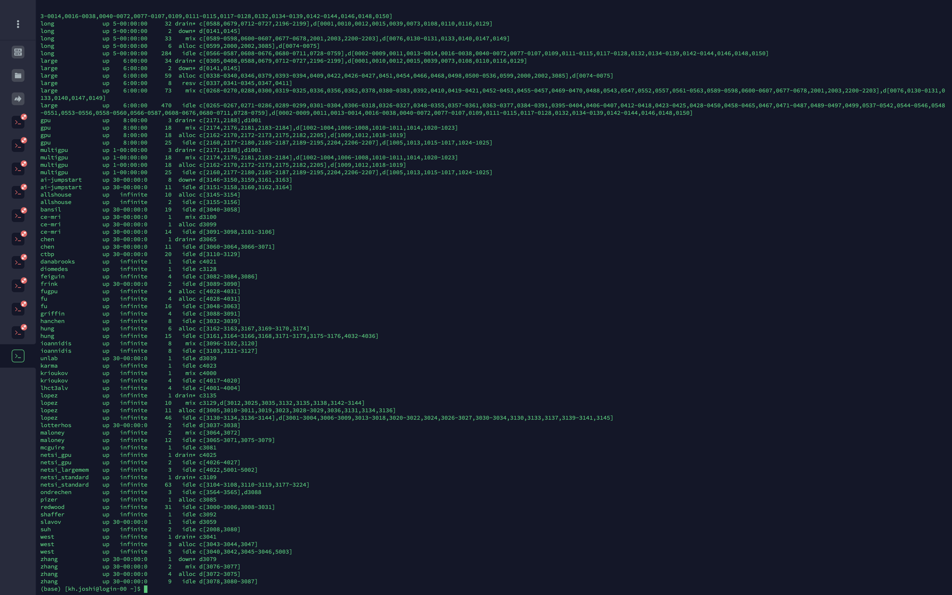
Other Partitions on Discovery
Customized partitions for various groups as per PI’s request
Use the command “sinfo” to see the complete list

Slide 42
DATA TRANSFER ON DISCOVERY
MAC | Using Terminal
 | Using SSHFS
 | Using Globus (recommended for transferring large files)
Windows | Using MobaXterm
 | Using FileZilla
 | Using Globus (recommended for transferring large files)
More details on https://rc-docs.northeastern.edu/en/latest/using-discovery/transferringdata.html
Details about Globus will be covered in the Understanding RC Storage Training session

Slide 43
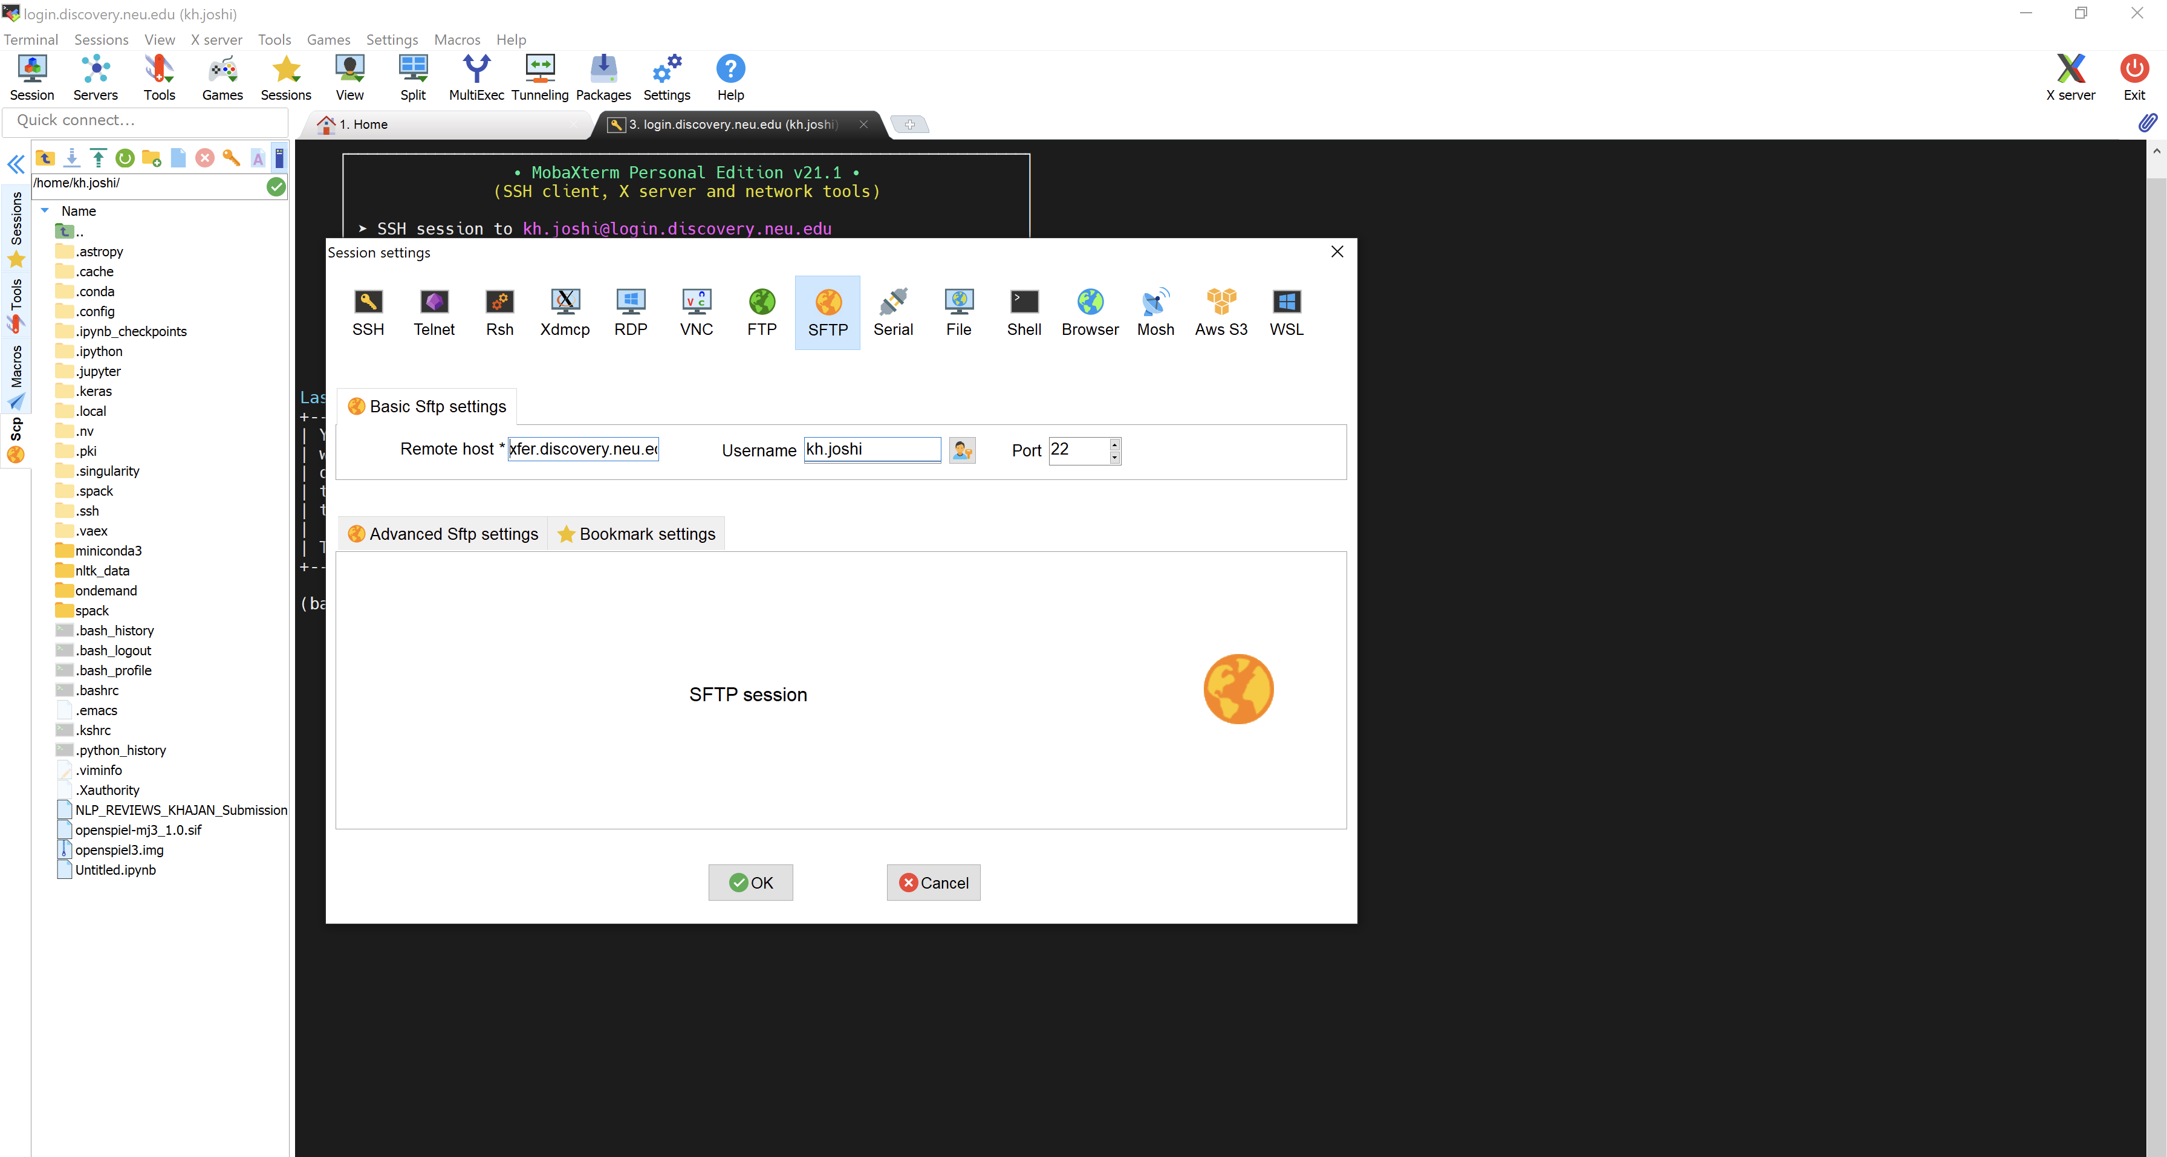
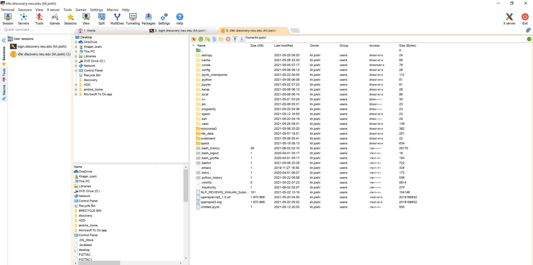
DATA TRANSFER ON DISCOVERY
Windows (Using MobaXterm)

Slide 44
USING MODULES ON DISCOVERY
Windows (Using MobaXterm)

